Slide 1
coded_reality
Zach Sadler
Khalif Coaxum
Sean Myers
&& Matthew Gould

Slide 2
coded_reality is a single player or cooperative puzzle game, geared towards learning to think critically and gain experience with programming.

Slide 3
An actor in a digital world faces impossible challenges. He cannot proceed unless he or his coder friend peels back the curtain of his reality and manipulates the underlying code.

Slide 4
/** * Story: * @param [Player] disgruntled_employee-- * Angry at his former place of work. * * @param [Player] AI – created by * [disgruntled_employee] and inserted into * the base layer of the company’s network. * * @return: void – return nothing because * you destroy it all. * * @TODO Find a writer; fill in specifics. **/

Slide 5
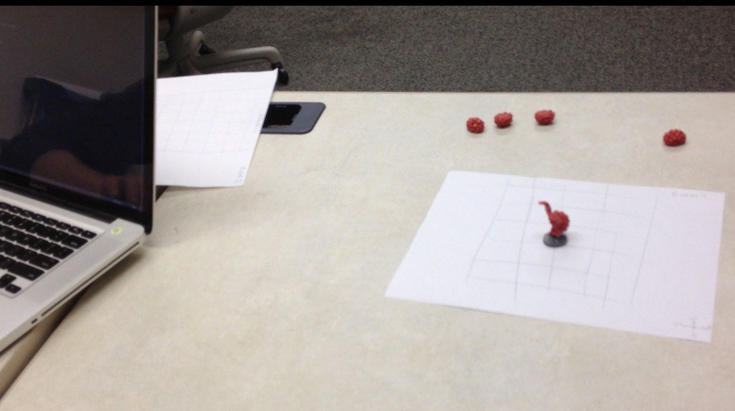
The Coder
The Actor

Slide 6
if (players == 1) { description = “minimum required”; type = “single player vs. game”; } else if (players == 2) { description = “preferred”; type = “cooperative play”; }
The Coder
The Actor

Slide 7
class Actor extends Player { Resources: Nothing; // to begin with Anything; // with help Procedures: Interact; // with the world Communicate; // with the coder Execute; // to advance }

Slide 8
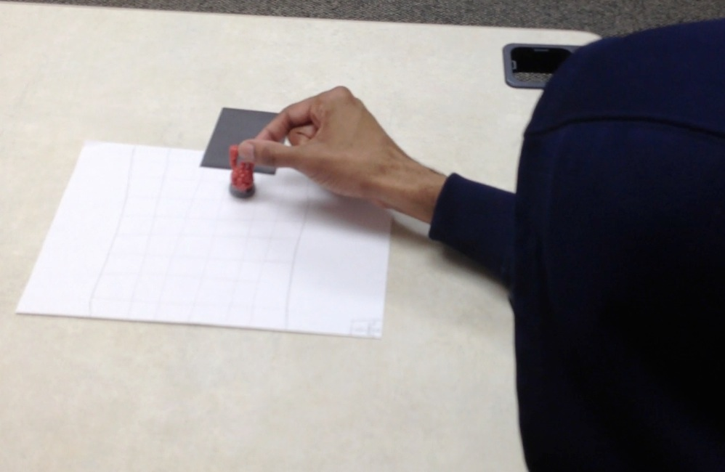

Slide 9
class Coder extends Player { Resources: Source; // the fabric of // the actor’s world Procedures: Manipulate; // the source Enable; // the player Communicate; // with the actor }

Slide 10
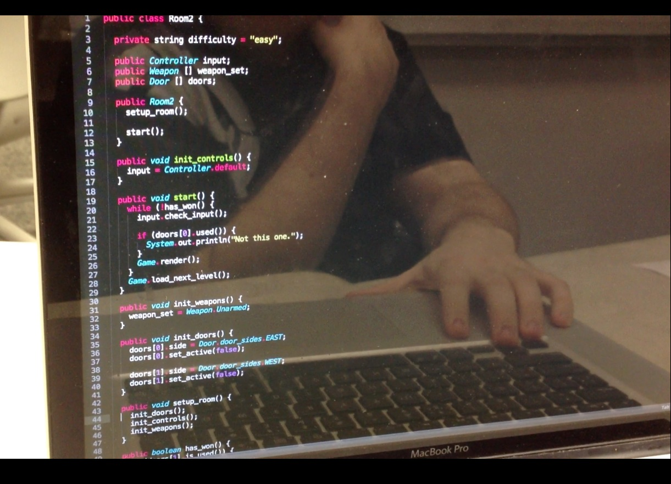

Slide 11
Rules Actor = “”” Can interact with anything in the digital world. “”” Coder = “”” Coder can only access files in his current directory. Coder can’t see the grey code, can’t touch the white code, and can edit the orange code. “””

Slide 12
Resources: { Lives: infinite, Health: limited, Time: stop_watch }

Slide 13
try { to_play(); } catch(AbilityNotFoundException e){} catch(NotAnAIException e){} catch(TryHardException e){} catch(TrollFormatException e){} catch(Exception e){}

Slide 14
while (!finished) { if (player_dead) { reset_level(); respawn(); } timer++; } printf(“You finished in %d seconds! \n”, timer);

Slide 15
Strengths = { Teaches without direct instruction, Asymmetric player roles, Single or cooperative play }

Slide 16
Why_Unity: GuiText Particle effects Mesh loader IDE with documentation (not Wild Magic)

Slide 17
Flexibility: Levels Terminal Source

Slide 18
Shame Layer A single level. A terminal with no commands. Button, lever, texture for door.

Slide 19
Disappointing Layer 3 levels. Access files in a single directory. Basic editing of files. World reacts to what you can change. Basic enemy AI. An enemy. A hammer.

Slide 20
Acceptable Layer 6 levels. Working terminal- ls, cd, directories. Lots of orange text in files. World seamlessly reacts to files. Difficult enemy AI. Font designed by Khalif. Basic weapons.

Slide 21
Awesome Layer 10 levels. Networking for cooperative play. AI (GLaDOS) working against you. Top-Down perspective, render player. Player character model.

Slide 22
NP-Complete Layer Procedurally generated levels. Room size is 10x bigger. Easter eggs. MMO. Cutscenes. Voice Acting. Motion capture.

